Slide 2
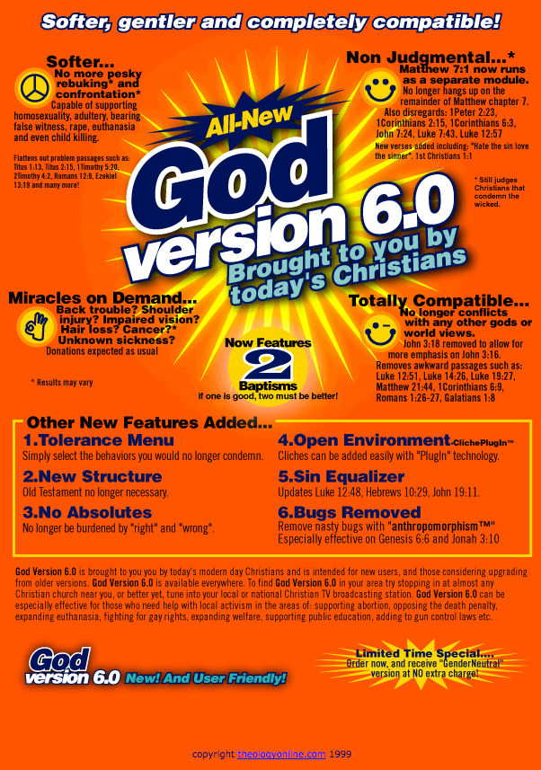
NICER
GOD?
THAN

Slide 3
Man is Saved By:
  GOD – Romans 8:33 “{It is} God who justifies."
  Titus 2:9,10 “adorn the doctrine of God our Savior”
  Romans 6:23 “the gift of God {is} eternal life”
  CHRIST – Luke 19:9,10 “the Son of Man has come to seek and to save that which was lost."
  Acts 13:23 “God raised up for Israel a Savior - Jesus."
  Philippians 3:20 “eagerly wait for the Savior, the Lord Jesus Christ."

Slide 4
Man is Saved By:
  THE WORD – James 1:21 “receive with meekness the implanted word, which is able to save your souls."
  1 Peter 1:25 “"but the word of the Lord endures forever." …the word which by the gospel was preached to you."
  Romans 1:16 “it is the power of God to salvation”
  GRACE – Romans 3:24 “justified freely by [God's] grace”
  Ephesians 2:8 “ by grace you have been saved through faith”

Slide 5
Man is Saved By:
  BLOOD OF CHRIST– Romans 5:7-9 " having now been justified by His blood, we shall be saved from wrath through Him."
  Hebrews 10:19 - Without the shedding of HIS blood, there would be NO SALVATION for ANYONE!
  FAITH – Romans 5:1 “having been justified by faith”
  Hebrews 11:6 – “he who comes to God must believe that He is, and…He is a rewarder of those who diligently seek Him."
  FAITH is ESSENTIAL!

Slide 6
Man is Saved By:
  REPENTANCE– Acts 17:30 "now commands all men everywhere to repent."
  2 Corinthians 7:10 “godly sorrow produces repentance to salvation”
  CONFESSION – Romans 10:9,10 “with the mouth confession is made to salvation.”
  Matthew 10:32,33 “whoever confesses Me before men, him I will also confess before My Father”

Slide 7
Man is Saved By:
  BAPTISM– Mark 16:16 "He who believes and is baptized will be saved"
  1 Peter 3:21 ”an antitype which now saves us, {namely} baptism”
  OBEDIENCE – Hebrews 5:8,9 “became the author of eternal salvation to all who obey Him”
  Matthew 10:32,33 “whoever confesses Me before men, him I will also confess before My Father”

Slide 8
Man is Saved By:
  WORKS – James 2:24 "a man is justified by works, and not by faith only."
  Christians expected to do the WORK which God commands in order to be justified in God’s sight.
  OBEDIENCE – Hebrews 5:8,9 “became the author of eternal salvation to all who obey Him”
  Matthew 10:32,33 “whoever confesses Me before men, him I will also confess before My Father”

Slide 9
NICER
GOD?
THAN
John 6:29

Slide 10
No Man, Woman, Child, Preacher, Teacher, Parent, etc.
Can Remove ONE THING from God’s list of essentials to man’s salvation!

